Slide 1
IBM CAPSTONE REPORT
LORENZO FRESNO AYUSO
ANALIZING TRAFFIC SEVERITY

Slide 2
Index
Introduction
Data Description and Cleaning
Exploratory Data Analysis
Model creation
Results
Discussion
Conclusions

Slide 3




INTRODUCTION – WHY ACCIDENTS?
Traffic accidents are a significant source of deaths, injuries, property damage, and a major concern for public health and traffic safety. Every year in the US(1):
4.4 million injured
38,000 dead
$871bn = total cost of accidents
$380bn = total health costs
Interested agents – target audience
Insurance companies
Public Administrations
Health institutions
Drivers
(1) Association for Safe International Road Travel

Slide 4
DATA DESCRIPTION AND CLEANING
General Information
Database name: Collisions
Data provider: IBM Coursera
Publisher: SDOT Traffic Management Division
194,673 simples x 37 attributes
Time scope: 2004 - 2019

Slide 5
DATA DESCRIPTION AND CLEANING
Feature Selection
Reason for dropping | Redundant index referring to another Feature | Consequence of the incident, cannot be input to predict severity
Dropped Features | COLDETKEY INTKEY LOCATION SDOT_COLCODE SDOTCOLNUM ST_COLCODE SEGLANEKEY CROSSWALKKEY EXCEPTRSNCODE EXCEPTRSNDESC | INJURIES FATALITIES
Kept Features | OBJECTID ADDRTYPE SEVERITY SEVERITYDESC COLLISIONTYPE PERSONCOUNT PEDCOUNT PEDCYLCOUNT VEHCOUNT INCDATE | UNDERINFL WEATHER ROADCOND LIGHTCOND SPEEDING HITPARKEDCAR INCDTTM JUNCTIONTYPE SDOT_COLDESC INATTENTIONIND
Many of the attributes were redundant or couldn’t be included in the model as they were consequences of the accident, rather than a possible driver
See Annex 1 for feature descriptors.

Slide 6
DATA DESCRIPTION AND CLEANING
Data Cleaning
NaN: Deleted all NaN rows, since dataset was large, and it was considered preferable to keep quality data.
Binarization: Transformed Yes/No cells into binary numbers, as well as severity.
Pearson correlation: after previous Feature selection, no other features had a large enough index to prove relevant redundancies.
Target variable: SEVERITY
Remaining features: 20 (including numerical and categorical)

Slide 7
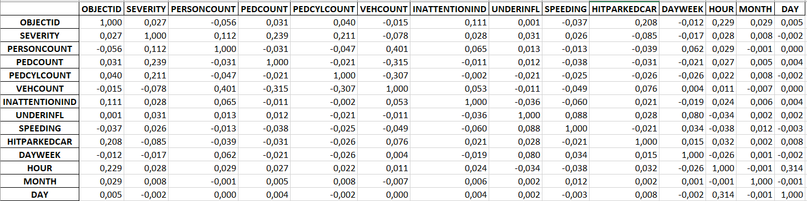
EXPLORATORY DATA ANALYSIS
Numerical Features
No relevant correlations shown between variables
Maximum p < 0.3

Slide 8
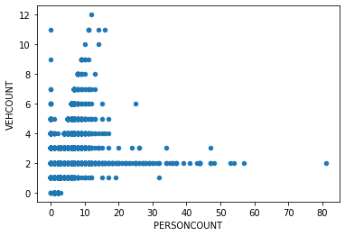
EXPLORATORY DATA ANALYSIS
Numerical Features
Positive correlatio between VEHCOUNT and PERSONCOUNT

Slide 9
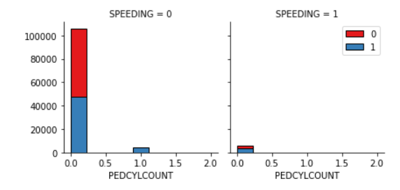
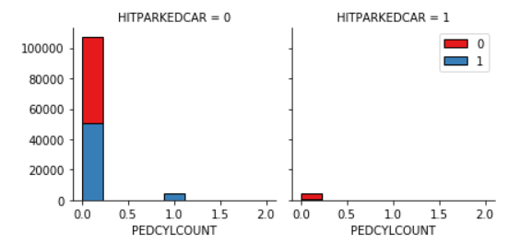
EXPLORATORY DATA ANALYSIS
Numerical Features
When speeding is involved, cases tend to be more severe.
If a parked car is hit, most often it’s only considered property damage.

Slide 10
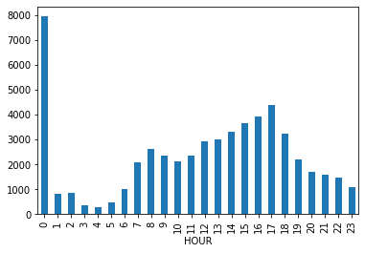
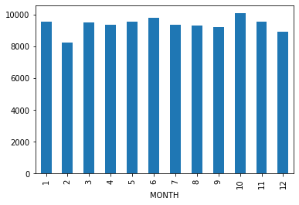
EXPLORATORY DATA ANALYSIS
Numerical Features
Created two new variables based on time of the accident:
HOUR: most accidents take place during rush hour (5pm)
MONTHS: no relevant patterns were found, accidents equally distributed.

Slide 11
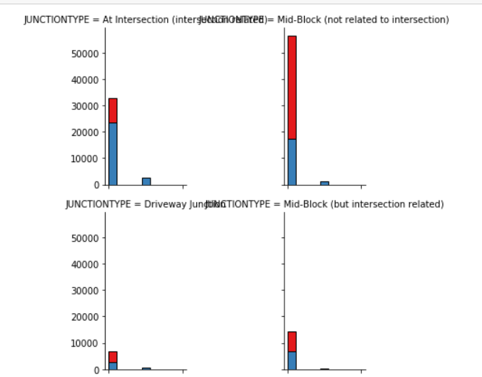
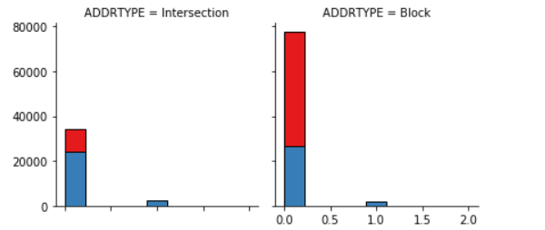
EXPLORATORY DATA ANALYSIS
Categorical Features
Severe accidents (blue) are more likely to happen in an intersection than just property damage

Slide 12
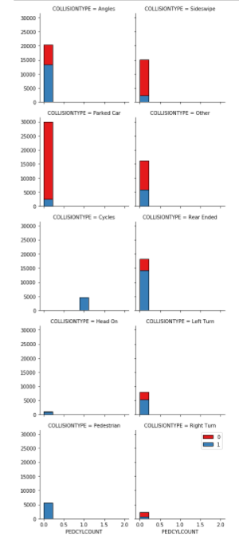
EXPLORATORY DATA ANALYSIS
Categorical Features
Most severe accidents take place in angles, in pedestrian areas and rear ended.

Slide 13
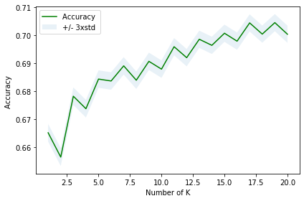
MODEL CREATION
Selected Variables
PERSONCOUNT PEDCOUNT UNDERINFL HITPARKEDCAR HOUR ADDRTYPE JUNCTIONTYPE COLLISIONTYPE
Chose variables →
Undersampling to achieve balanced data
One-hot encoding for categorical features
Divide train and test datasets (20% test)
Create 4 Models: KNN, Decision Tree, Logistic Regression and SVM
Note: for KNN chose the most suitable K based on máximum accuracy. (k = 17)

Slide 14
RESULTS
Similar evaluation metrics (aprox 70%)
Best performance of SVM but also longer running times.
Algorithm | Accuracy Score | Jaccard | F1 Score | Log Loss
KNN | 0.70 | 0.70 | 0.70 | NA
Decision Tree | 0.70 | 0.66 | 0.64 | NA
SVM | 0.71 | 0.71 | 0.71 | NA
LR | 0.70 | 0.70 | 0.70 | 0.55
←

Slide 15
DISCUSSION & CONCLUSION
The algorith uses data related with:
#People in the vehicle
Location
Type of intersection
Accident type
Time of the accident
Driver factors: speeding and alcohol intake.
70 %
Average accuracy
Next steps
Vehicle conditions: brand, type, age, etc.
Driver conditions: age, health, previous driving history, time since license obtained.
Insurance type

